Slide 1
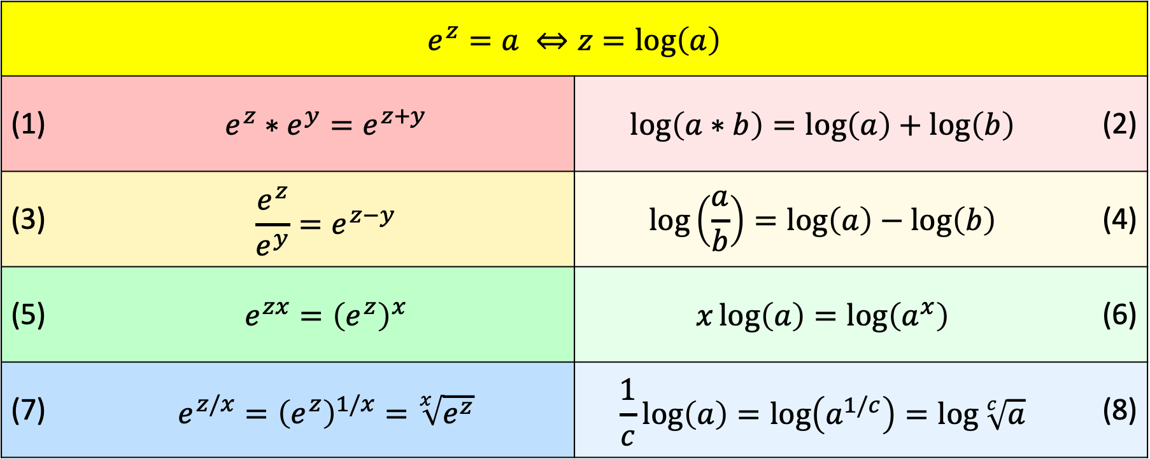
Properties of Logarithms
$$e^{z}=a ⇔z=\log\left(a\right)$$ | $$e^{z}=a ⇔z=\log\left(a\right)$$
(1) | $$e^{z}∗e^{y}=e^{z+y}$$ | $$\log\left(a∗b\right)=\log\left(a\right)+\log\left(b\right)$$ | (2)
(3) | $$\frac{e^{z}}{e^{y}}=e^{z−y}$$ | $$\log\left(\frac{a}{b}\right)=\log\left(a\right)−\log\left(b\right)$$ | (4)
(5) | $$e^{zx}={\left(e^{z}\right)}^{x}$$ | $$x\log\left(a\right)=\log\left(a^{x}\right)$$ | (6)
(7) | $$e^{z/x}={\left(e^{z}\right)}^{1/x}=\sqrt[x]{e^{z}}$$ | $$\frac{1}{c}\log\left(a\right)=\log\left(a^{1/c}\right)=\log{\sqrt[c]{a}}$$ | (8)

Slide 2
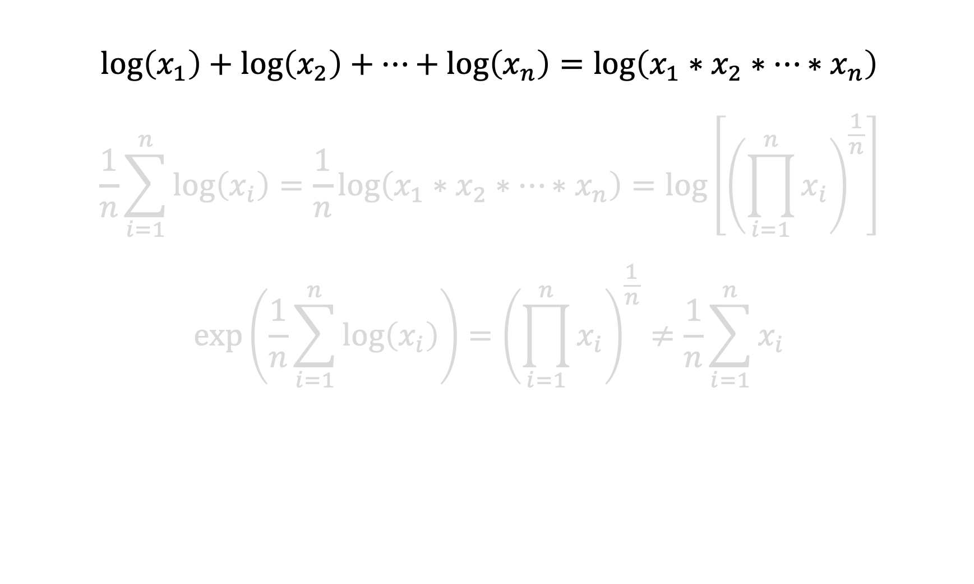
Mean of logs = log(Geometric Mean)
$$\log\left(x_{1}\right)+\log\left(x_{2}\right)+…+\log\left(x_{n}\right)=\log\left(x_{1}∗x_{2}∗…∗x_{n}\right)$$
$$\frac{1}{n}\sum_{i=1}^{n}{\log\left(x_{i}\right)}=\frac{1}{n}\log\left(x_{1}∗x_{2}∗…∗x_{n}\right)=\log\left[{\left(\prod_{i=1}^{n}{x_{i}}\right)}^{\frac{1}{n}}\right]$$
$$\exp\left(\frac{1}{n}\sum_{i=1}^{n}{\log\left(x_{i}\right)}\right)={\left(\prod_{i=1}^{n}{x_{i}}\right)}^{\frac{1}{n}}≠\frac{1}{n}\sum_{i=1}^{n}{x_{i}}$$
Applying Property (2): the sum of logs is the log of the product

Slide 3
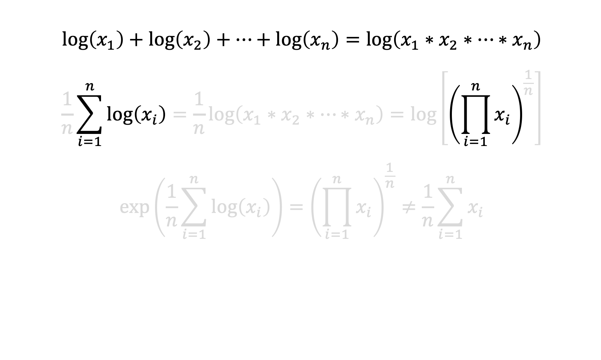
Mean of logs = log(Geometric Mean)
$$\log\left(x_{1}\right)+\log\left(x_{2}\right)+…+\log\left(x_{n}\right)=\log\left(x_{1}∗x_{2}∗…∗x_{n}\right)$$
$$\frac{1}{n}\sum_{i=1}^{n}{\log\left(x_{i}\right)}=\frac{1}{n}\log\left(x_{1}∗x_{2}∗…∗x_{n}\right)=\log\left[{\left(\prod_{i=1}^{n}{x_{i}}\right)}^{\frac{1}{n}}\right]$$
$$\exp\left(\frac{1}{n}\sum_{i=1}^{n}{\log\left(x_{i}\right)}\right)={\left(\prod_{i=1}^{n}{x_{i}}\right)}^{\frac{1}{n}}≠\frac{1}{n}\sum_{i=1}^{n}{x_{i}}$$
Expressing the sum using summation notation
Expressing the product using product notation

Slide 4
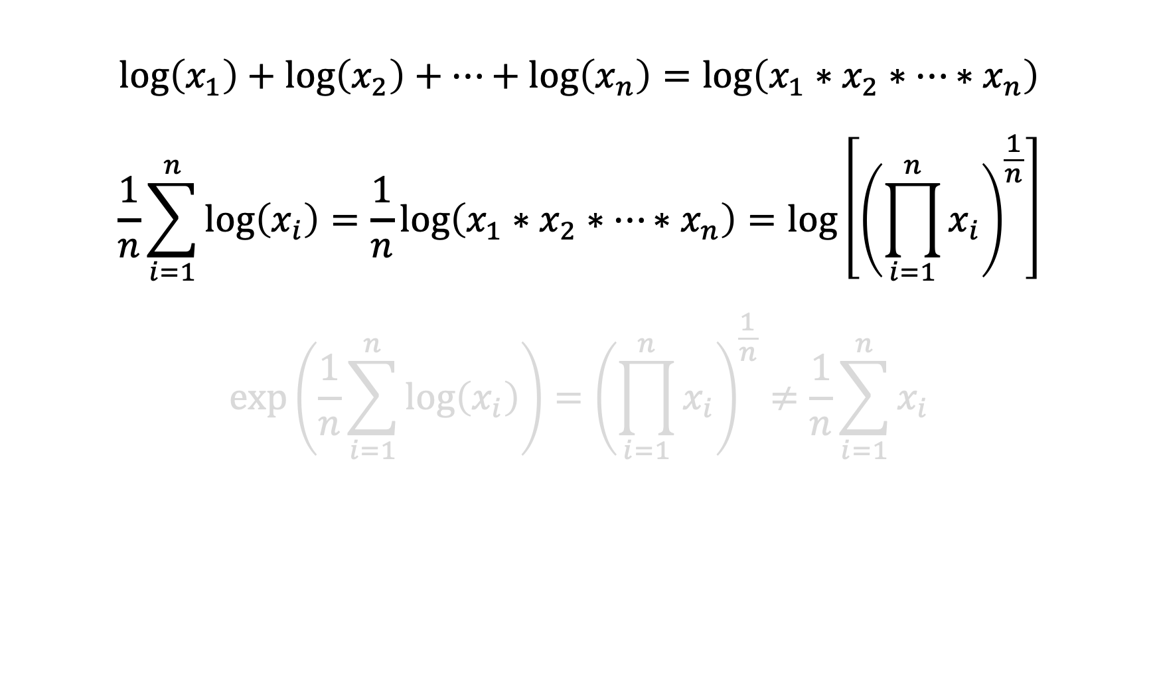
Mean of logs = log(Geometric Mean)
$$\log\left(x_{1}\right)+\log\left(x_{2}\right)+…+\log\left(x_{n}\right)=\log\left(x_{1}∗x_{2}∗…∗x_{n}\right)$$
$$\frac{1}{n}\sum_{i=1}^{n}{\log\left(x_{i}\right)}=\frac{1}{n}\log\left(x_{1}∗x_{2}∗…∗x_{n}\right)=\log\left[{\left(\prod_{i=1}^{n}{x_{i}}\right)}^{\frac{1}{n}}\right]$$
$$\exp\left(\frac{1}{n}\sum_{i=1}^{n}{\log\left(x_{i}\right)}\right)={\left(\prod_{i=1}^{n}{x_{i}}\right)}^{\frac{1}{n}}≠\frac{1}{n}\sum_{i=1}^{n}{x_{i}}$$
Applying Property (8)

Slide 5
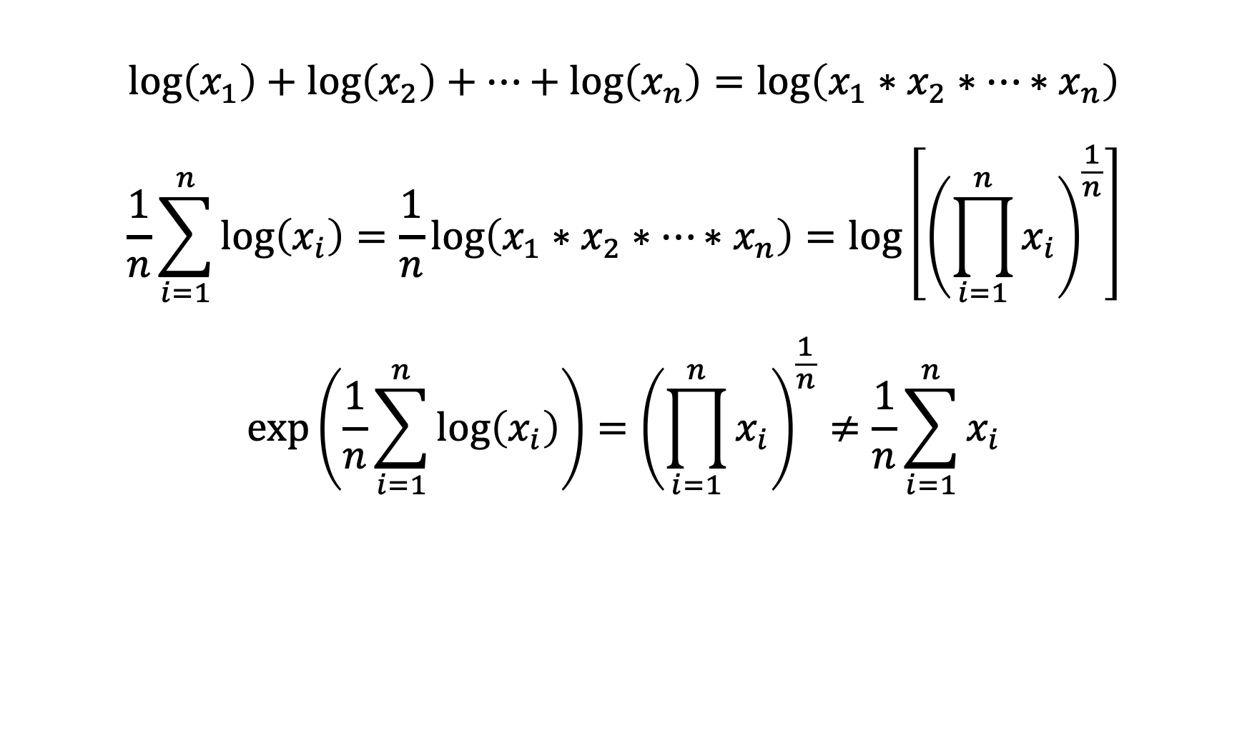
Mean of logs = log(Geometric Mean)
$$\log\left(x_{1}\right)+\log\left(x_{2}\right)+…+\log\left(x_{n}\right)=\log\left(x_{1}∗x_{2}∗…∗x_{n}\right)$$
$$\frac{1}{n}\sum_{i=1}^{n}{\log\left(x_{i}\right)}=\frac{1}{n}\log\left(x_{1}∗x_{2}∗…∗x_{n}\right)=\log\left[{\left(\prod_{i=1}^{n}{x_{i}}\right)}^{\frac{1}{n}}\right]$$
$$\exp\left(\frac{1}{n}\sum_{i=1}^{n}{\log\left(x_{i}\right)}\right)={\left(\prod_{i=1}^{n}{x_{i}}\right)}^{\frac{1}{n}}≠\frac{1}{n}\sum_{i=1}^{n}{x_{i}}$$
Exponentiating both sides of the equation

Slide 6
Mean of logs = log(Geometric Mean)
$$\log\left(x_{1}\right)+\log\left(x_{2}\right)+…+\log\left(x_{n}\right)=\log\left(x_{1}∗x_{2}∗…∗x_{n}\right)$$
$$\frac{1}{n}\sum_{i=1}^{n}{\log\left(x_{i}\right)}=\frac{1}{n}\log\left(x_{1}∗x_{2}∗…∗x_{n}\right)=\log\left[{\left(\prod_{i=1}^{n}{x_{i}}\right)}^{\frac{1}{n}}\right]$$
$$\exp\left(\frac{1}{n}\sum_{i=1}^{n}{\log\left(x_{i}\right)}\right)={\left(\prod_{i=1}^{n}{x_{i}}\right)}^{\frac{1}{n}}≠\frac{1}{n}\sum_{i=1}^{n}{x_{i}}$$
Sample mean of log-transformed observations

Slide 7
Mean of logs = log(Geometric Mean)
$$\log\left(x_{1}\right)+\log\left(x_{2}\right)+…+\log\left(x_{n}\right)=\log\left(x_{1}∗x_{2}∗…∗x_{n}\right)$$
$$\frac{1}{n}\sum_{i=1}^{n}{\log\left(x_{i}\right)}=\frac{1}{n}\log\left(x_{1}∗x_{2}∗…∗x_{n}\right)=\log\left[{\left(\prod_{i=1}^{n}{x_{i}}\right)}^{\frac{1}{n}}\right]$$
$$\exp\left(\frac{1}{n}\sum_{i=1}^{n}{\log\left(x_{i}\right)}\right)={\left(\prod_{i=1}^{n}{x_{i}}\right)}^{\frac{1}{n}}≠\frac{1}{n}\sum_{i=1}^{n}{x_{i}}$$
Geometric mean of original observations

Slide 8
Mean of logs = log(Geometric Mean)
$$\log\left(x_{1}\right)+\log\left(x_{2}\right)+…+\log\left(x_{n}\right)=\log\left(x_{1}∗x_{2}∗…∗x_{n}\right)$$
$$\frac{1}{n}\sum_{i=1}^{n}{\log\left(x_{i}\right)}=\frac{1}{n}\log\left(x_{1}∗x_{2}∗…∗x_{n}\right)=\log\left[{\left(\prod_{i=1}^{n}{x_{i}}\right)}^{\frac{1}{n}}\right]$$
$$\exp\left(\frac{1}{n}\sum_{i=1}^{n}{\log\left(x_{i}\right)}\right)={\left(\prod_{i=1}^{n}{x_{i}}\right)}^{\frac{1}{n}}≠\frac{1}{n}\sum_{i=1}^{n}{x_{i}}$$
So exponentiating the sample mean on the log-scale returns the geometric mean on the original scale

Slide 9
Mean of logs = log(Geometric Mean)
$$\log\left(x_{1}\right)+\log\left(x_{2}\right)+…+\log\left(x_{n}\right)=\log\left(x_{1}∗x_{2}∗…∗x_{n}\right)$$
$$\frac{1}{n}\sum_{i=1}^{n}{\log\left(x_{i}\right)}=\frac{1}{n}\log\left(x_{1}∗x_{2}∗…∗x_{n}\right)=\log\left[{\left(\prod_{i=1}^{n}{x_{i}}\right)}^{\frac{1}{n}}\right]$$
$$\exp\left(\frac{1}{n}\sum_{i=1}^{n}{\log\left(x_{i}\right)}\right)={\left(\prod_{i=1}^{n}{x_{i}}\right)}^{\frac{1}{n}}≠\frac{1}{n}\sum_{i=1}^{n}{x_{i}}$$
Exponentiating the sample mean on the log-scale DOES NOT give the mean on the original scale

